Slide 1
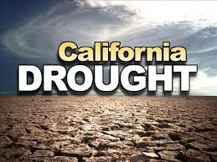
Presented by Corey Lee Wilson IFMA IE Chapter President & FMP; LEED AP O&M

Slide 2
Worst drought on record so far this year!
With California facing one of the most severe droughts on record, Governor Brown declared a drought State of Emergency in January 2014 and directed state officials to take all necessary actions to prepare for water shortages.

Slide 3
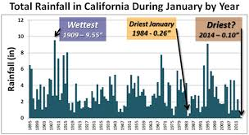
California’s Leaders React to Historic Drought
Gov. Brown convened an interagency Drought Task Force to provide a coordinated assessment of the State’s dry conditions and provide recommendations on current and future state actions.
Mandatory Water Conservation Regulation went into effect on July 29, 2014 - The new conservation regulation from the State Water Board targets outdoor urban water use.
In support of this unified effort, all state agencies with a role in supporting drought mitigation and relief efforts are organized under the Incident Command System.
California’s legislature approved yesterday August 13, 2014, a $7.5 billion water plan for the November 2014 ballot.

Slide 4
Ways We Can Save and Reduce Water Use By:
Monitoring water usage performance
Reducing indoor potable water consumption
Reducing process water usage
Practicing water efficient landscaping

Slide 5
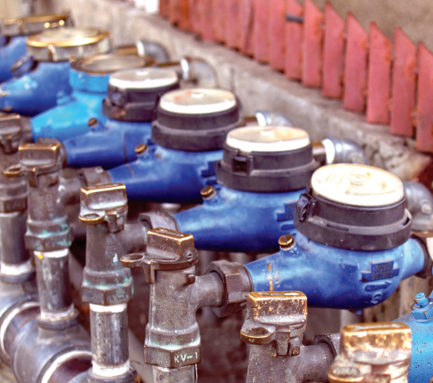
Monitoring Water Usage Performance
Efficiency measures can reduce water use by 30% or more.
First step to improving water efficiency is to understand current performance.
By tracking water use alongside energy use, organizations can better understand how these resources relate to each other.
Make integrated management decisions that increase overall efficiency and verify savings from improvement projects in both water and energy systems.

Slide 6
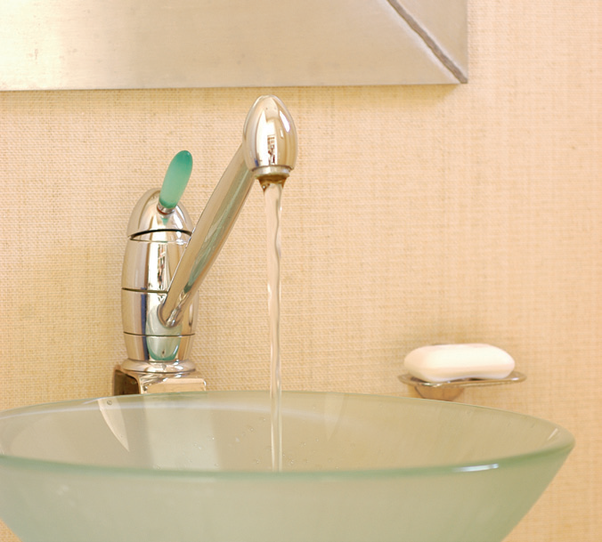
Reducing Indoor Potable Water Consumption
Example: A Boston building installed 30 faucet aerators and reduced annual indoor water consumption by 190,000 gallons. Cost of the materials and labor totaled $300, and the change saved $1,250 per year, with a return on investment (ROI) of 2 months.
Install building upgrades such as:
Low consumption and dual flush toilets
Flow restrictors on existing fixtures
Electronic controls
Waterless urinals
Tankless water heaters

Slide 7
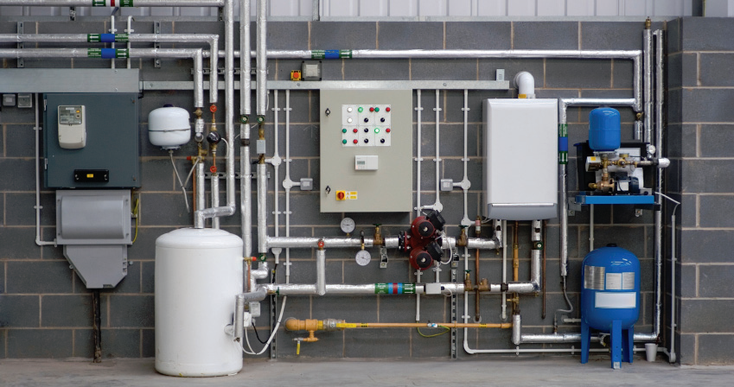
Reducing Process Water Usage
Process water includes the water used in dishwashers, clothes washers, and ice machines. It also refers to water used for industrial purposes and in building systems such as boilers and chillers.
Upgrade costs can be large and ROI long, so they may be cost-effective only under certain building and site conditions.

Slide 8
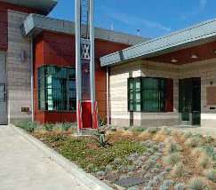
Practicing Water Efficient Landscaping
Landscape irrigation practices consume large quantities of potable water and account for 30% of the 26 billion gallons of water consumed daily in US.
Select efficient technologies by installing sub-meters, irrigation sensors, and drip irrigation.
Use water efficient landscaping materials such as native and adaptive plants (xeriscaping), minimize areas with conventional turf grass, and use mulching and composting strategies for optimal soil conditions.

Slide 9
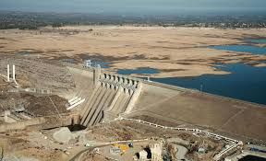
Which of the following water efficiency systems do you use or plan to use?
Waterless urinals
Low and dual-flush toilets
Low-flow showerheads and faucets
Drip irrigation systems
Submeters
Recycled process water

Slide 10
Ask the WMWD Experts
Mallory Gandara
MGandara@wmwd.com
Water Use Efficiency for Commercial Business
Pamela Pavela
PPavela@wmwd.com
Landscape Programs, Rebates, and Resources

